Slide 1
International Portfolio Management

Slide 2
Sections
Correlation structure
Optimal portfolio selection
The relationship among $ return, local return, and exchange rate
Home bias
International money market (CH 11, pp. 272-281)
International bond market (CH 12, pp. 305-319)
International equity market (CH 13, pp. 326-342.)

Slide 3
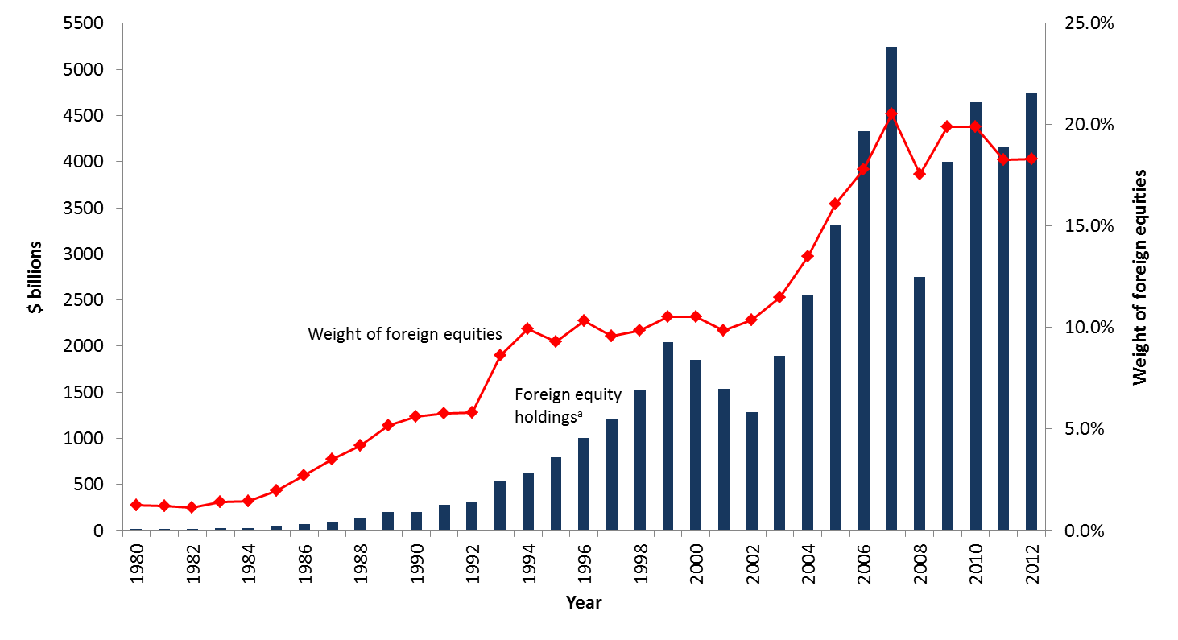
U.S. investment in foreign equities

Slide 4
International correlation structure
Security returns are much less correlated across countries than within a country.
This is true because economic, political, institutional, and even psychological factors affecting security returns tend to vary across countries, resulting in low correlations among international securities.
Business cycles are often asynchronous across countries.

Slide 5
Domestic vs. international diversification
When fully diversified, an international portfolio can be less than half as risky as a purely U.S. portfolio.
A fully diversified international portfolio is only 12 percent as risky as holding a single security.
Portfolio Risk (%)
0.44
Swiss stocks
0.27
U.S. stocks
0.12
International stocks
Number of Stocks
10 20 30 40 50

Slide 6
Summary statistics of the monthly returns: 1980 – 2012 (all statistics in U.S. dollars)
 | Correlation Coefficients
 |  |  |  |  |  |  |  |  |  |  |  | Mean | SD
Stock Market | AU | CN | FR | GM | HK | IT | JP | NL | SD | SW | UK | (%) | (%) | βª | SHP^{b} | (Rank)
Australia (AU) |  |  |  |  |  |  |  |  |  |  |  | 0.550 | 7.18 | 1.09 | 0.074 | (9)
Canada (CN) | 0.69 |  |  |  |  |  |  |  |  |  |  | 0.549 | 6.11 | 1.04 | 0.087 | (6)
France (FR) | 0.56 | 0.59 |  |  |  |  |  |  |  |  |  | 0.551 | 6.73 | 1.13 | 0.079 | (8)
Germany (GM) | 0.55 | 0.60 | 0.79 |  |  |  |  |  |  |  |  | 0.565 | 6.87 | 1.14 | 0.080 | (7)
Hong Kong (HK) | 0.55 | 0.52 | 0.38 | 0.42 |  |  |  |  |  |  |  | 0.664 | 9.04 | 1.03 | 0.071 | (10)
Italy (IT) | 0.46 | 0.53 | 0.67 | 0.64 | 0.37 |  |  |  |  |  |  | 0.450 | 7.57 | 1.07 | 0.057 | (12)
Japan (JP) | 0.39 | 0.40 | 0.45 | 0.41 | 0.30 | 0.40 |  |  |  |  |  | 0.437 | 6.59 | 0.99 | 0.064 | (11)
Netherlands (NL) | 0.61 | 0.67 | 0.79 | 0.81 | 0.49 | 0.62 | 0.47 |  |  |  |  | 0.635 | 5.97 | 1.08 | 0.103 | (4)
Sweden (SD) | 0.60 | 0.62 | 0.65 | 0.70 | 0.45 | 0.59 | 0.43 | 0.70 |  |  |  | 1.008 | 7.51 | 1.23 | 0.132 | (3)
Switzerland (SW) | 0.55 | 0.58 | 0.71 | 0.76 | 0.40 | 0.52 | 0.47 | 0.76 | 0.63 |  |  | 0.709 | 5.42 | 0.89 | 0.133 | (2)
United Kingdom | 0.68 | 0.69 | 0.71 | 0.67 | 0.53 | 0.58 | 0.48 | 0.78 | 0.65 | 0.69 |  | 0.550 | 5.59 | 1.01 | 0.095 | (5)
United States (US) | 0.63 | 0.77 | 0.65 | 0.65 | 0.48 | 0.51 | 0.38 | 0.73 | 0.67 | 0.65 | 0.72 | 0.647 | 4.59 | 0.88 | 0.137 | (1)

Slide 7
Sharpe performance measure
Sharpe performance measure (SHP, also called Sharpe ratio) is a risk-adjusted performance measure:
SHP_{i} = [Mean(R_{i}) – R_{f}]/σ_{i}

Slide 8
Average correlation among 10 major international stock markets over time, 1980 – 2012
Australia, Canada, France, Germany, Hong Kong, Italy, Japan, Netherlands, the UK and the U.S.

Slide 9
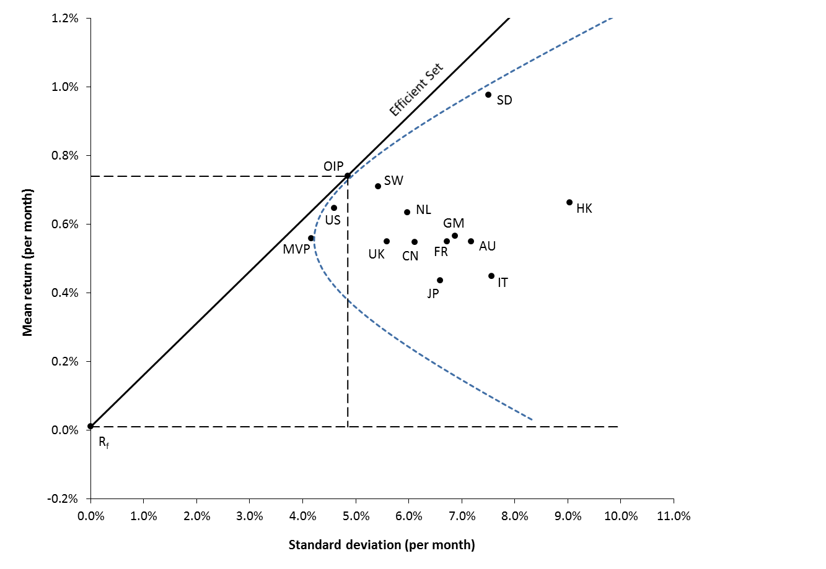
Optimal international portfolio, 1980-2012

Slide 10
Diversification gain by investor’s domicile, 1980 – 2012
 | Domestic Portfolio |  |  |  | Optimal International Portfolio |  |  |  | Gains from International Investment
Investor's Domicile | Mean (%) | SD (%) | SHP |  | Mean (%) | SD (%) | SHP |  | ΔSHP | (Δ%)ª | ΔR(%)^{b} | (%p.a.)^{c}
Australia (AU) | 0.56 | 5.43 | 0.068 |  | 0.83 | 4.78 | 0.133 |  | 0.065 | (95) | (0.35) | (4.23)
Canada (CN) | 0.51 | 4.98 | 0.086 |  | 0.73 | 4.39 | 0.147 |  | 0.061 | (71) | (0.30) | (3.65)
France (FR) | 0.61 | 6.00 | 0.100 |  | 0.83 | 4.95 | 0.168 |  | 0.067 | (67) | (0.40) | (4.85)
Germany (GM) | 0.53 | 6.18 | 0.085 |  | 0.77 | 5.10 | 0.149 |  | 0.064 | (76) | (0.40) | (4.78)
Hong Kong (HK) | 0.78 | 8.71 | 0.087 |  | 0.85 | 4.81 | 0.173 |  | 0.086 | (98) | (0.75) | (8.95)
Italy (IT) | 0.60 | 6.93 | 0.086 |  | 0.93 | 4.95 | 0.187 |  | 0.100 | (116) | (0.69) | (8.33)
Japan (JP) | 0.17 | 5.72 | 0.028 |  | 0.63 | 6.65 | 0.093 |  | 0.066 | (236) | (0.38) | (4.51)
Netherlands (NL) | 0.60 | 5.57 | 0.108 |  | 0.77 | 5.08 | 0.150 |  | 0.043 | (39) | (0.24) | (2.84)
Sweden (SD) | 1.13 | 6.90 | 0.148 |  | 0.91 | 4.69 | 0.173 |  | 0.025 | (17) | (0.17) | (2.05)
Switzerland (SW) | 0.57 | 4.89 | 0.120 |  | 0.76 | 5.03 | 0.153 |  | 0.033 | (28) | (0.16) | (1.94)
United Kingdom (UK) | 0.63 | 4.85 | 0.122 |  | 0.86 | 5.14 | 0.159 |  | 0.038 | (31) | (0.18) | (2.19)
United States (US) | 0.65 | 4.59 | 0.137 |  | 0.75 | 4.86 | 0.151 |  | 0.014 | (10) | (0.06) | (0.78)
Notes:
ªThe number provided in parentheses represents the percentage increase in the Sharpe performance measure relative to that of the domestic portfolio, i.e.,
[Δ𝑆𝐻𝑃/𝑆𝐻𝑃(𝐷𝑃)]×100, where Δ𝑆𝐻𝑃 denotes the difference in the Sharpe ratio between the optimal international portfolio and the domestic portfolio
^{b}This column provides the extra return accruing to the optimal international portfolio at the domestic-equivalent risk level.
^{c}This column provides the annualized extra return accruing to the optimal international portfolio.

Slide 11
Composition of the optimal portfolio by investors’ domicile, 1980 – 2012
 | From the perspective of Investors Domiciled in
Stock Market | AU | CN | FR | GM | HK | IT | JP | NL | SD | SW | UK | US | LCª
Australia (AU) | 0.0650 |  |  |  |  |  |  |  |  |  |  |  | 0.0099
Canada (CN)
France (FR)
Germany (GM)
Hong Kong (HK) |  | 0.0020 |  |  | 0.0307 |  |  |  |  |  |  |  | 0.0171
Italy (IT)
Japan (JP) |  | 0.0015 | 0.0043 |  | 0.0054 | 0.0104 |  |  | 0.0053
Netherlands (NL)
Sweden (SD) | 0.4372 | 0.2962 | 0.2596 | 0.3210 | 0.1950 | 0.2558 | 0.6409 | 0.3121 | 0.3220 | 0.3319 | 0.3073 | 0.2431 | 0.5378
Switzerland (SW) | 0.2688 | 0.2365 | 0.6338 | 0.6233 | 0.3239 | 0.5654 | 0.3591 | 0.6245 | 0.5323 | 0.6681 | 0.4541 | 0.2797
United Kingdom (UK) |  |  |  |  |  |  |  |  |  |  | 0.0770 |  | 0.0748
United States (US) | 0.2290 | 0.4638 | 0.1022 | 0.0558 | 0.4450 | 0.1684 |  | 0.0635 | 0.1404 |  | 0.1616 | 0.4772 | 0.3604
Total | 1.0000 | 1.0000 | 1.0000 | 1.0000 | 1.0000 | 1.0000 | 1.0000 | 1.0000 | 1.0000 | 1.0000 | 1.0000 | 1.0000 | 1.0000
Risk-free rate (%)^{b} | 0.1958 | 0.0817 | 0.0050 | 0.0050 | 0.0192 | 0.0050 | 0.0075 | 0.0050 | 0.1032 | -0.0129 | 0.0408 | 0.0179 | 0.0179
Notes:
ªLC column provides the composition of the optimal international portfolio without considering exchange rate changes.
^{b}The risk-free rate denotes the risk-free interest rate faced by investors domiciled in the corresponding country in December 2012. It is proxied by the one-month Treasury bill rate or eurocurrency interest rate.

Slide 12
Effects of changes in the exchange rate
The realized dollar return for a U.S. resident investing in a foreign market is given by
R_{i$} = (1 + R_{i})(1 + e_{i}) – 1 = R_{i} + e_{i} + R_{i}e_{i}
where
R_{i} is the local currency return in the i^{th} market.
e_{i} is the rate of change in the exchange rate between the local currency and the dollar.

Slide 13
Example
Suppose that a U.S. resident just sold shares in a British firm that had a 15% (local) return in pounds during a period when £ depreciated 5%, his $ return is 9.25%:
R_{i$} = (1 + .15)(1 – 0.05) – 1 = 0.925
= .15 + –.05 + .15×(–.05) = 0.925

Slide 14
Variance decomposition
Reall R_{i$} = (1 + R_{i})(1 + e_{i}) – 1 = R_{i} + e_{i} + R_{i}e_{i}
The risk for a U.S. resident investing in a foreign market will depend not only on the risk in the foreign market but also on the risk in the exchange rate between the U.S. dollar and the foreign currency.
Var(R_{i$}) = Var(R_{i}) + Var(e_{i}) + 2Cov(R_{i},e_{i}) + ΔVar
The ΔVar term represents the contribution of the cross-product term, R_{i}e_{i}, to the risk of foreign investment.

Slide 15
Effects of changes in the exchange rate
Var(R_{i$}) = Var(R_{i}) + Var(e_{i}) + 2Cov(R_{i},e_{i}) + ΔVar
This equation demonstrates that exchange rate fluctuations contribute to the risk of foreign investment through three channels:
Its own volatility, Var(e_{i}).
Its covariance with the local market returns Cov(R_{i},e_{i}).
The contribution of the cross-product term, ΔVar.

Slide 16
Variance decomposition, 1990-2012

Slide 17
Implication for equity investing
Based on Var(R_{i}), $ return is largely driven by local return.
Changes in exchange rate plays a secondary role, as evident by the size of Var(e_{i}).

Slide 18
Implication for bond investing
Based on VAR(e_{i}), there is substantial exchange rate risk in foreign bond investment.
This suggests that investors may be able to increase their gains if they can diversify exchange rate risk away internationally.
This also suggests that investors may be able to control this risk with currency forward contracts or swaps; i.e., hedging.

Slide 19
Composition of the optimal bond portfolio, 1990 – 2012, monthly returns, $
 | Correlation Coefficient |  |  |  |  |  |  |  |  | Optimal International Portfolioª
Bond Market | AU | CN | GM | JP | SW | UK | Mean (%) | SD (%) | SHP | (Weights)
Australia (AU) |  |  |  |  |  |  | 0.40 | 3.77 | 0.10 | 0.1439
Canada (CN) | 0.68 |  |  |  |  |  | 0.30 | 2.82 | 0.10 | 0.3629
Germany (GM) | 0.50 | 0.42 |  |  |  |  | 0.27 | 3.40 | 0.07 | -0.6597
Japan (JP) | 0.27 | 0.19 | 0.45 |  |  |  | 0.45 | 3.63 | 0.12 | 0.3456
Switzerland (SW) | 0.42 | 0.32 | 0.82 | 0.50 |  |  | 0.44 | 3.61 | 0.12 | 0.6329
United Kingdom (UK) | 0.46 | 0.48 | 0.71 | 0.33 | 0.60 |  | 0.27 | 3.23 | 0.08 | 0.0731
United States (US) | 0.35 | 0.36 | 0.49 | 0.36 | 0.36 | 0.41 | 0.16 | 2.17 | 0.07 | 0.1014
Optimal International Portfolio : |  |  |  |  |  |  | 0.46 | 2.64 | 0.17

Slide 20
Home bias in portfolio holdings
As previously shown, investors can potentially benefit a great deal from international diversification.
The actual portfolios that investors hold, however, are quite different from those predicted by the theory of international portfolio investment.
Home bias refers to the extent to which portfolio investments are concentrated in domestic assets.

Slide 21
Home bias in equity portfolios
Country | Share in World Market Value | Proportion of Domestic Equities in Portfolio
Australia | 1.70 | 78.91
Brazil | 0.71 | 100.00
Canada | 2.67 | 28.67
Germany | 3.21 | 29.35
Japan | 9.29 | 98.50
Sweden | 1.00 | 48.56
United Kingdom | 7.64 | 42.95
United States | 44.86 | 86.88

Slide 22
Why home bias?
Three conventional explanations:
Domestic equities may provide a superior inflation hedge.
Home bias may reflect institutional and legal restrictions on foreign investment.
Extra taxes and transactions/information costs for foreign securities may give rise to home bias.

Slide 23
Why home bias?
Bailey et al. (2004) found that wealthier, more experienced, sophisticated investors are more likely to invest in foreign securities.
Chan et al. (2005) found that when a country is remote and has an uncommon language, foreign investors tend to stay away.

Slide 24
Structuring international investing
Most international institutional investors use the top-down approach because they value the importance of asset allocation.
The process is structured along the lines of the national market influences (national market factors are the major factors).
The entire structure has 4 stages.

Slide 25
Stage 1
Market analysis and security analysis
International research department
Generate forecasts on exchange rates, interest rates, commodity prices, and national stock market returns.
Provide expected returns and risk sensitivities measured in $, along with recommendations, on individual securities.
Maintain an active list of individual securities in each asset class.
Provide properly undated expected returns and expected covariance matrix measured in $ (this is no easy task).

Slide 26
Stage 2
Asset allocation
Strategist or investment policy committee
Computer-based (mean-variance) optimization models or subjective judgment
Once asset allocation decision is made, the asset allocation mixture should appear on portfolio managers’ terminals.

Slide 27
Yale endowment

Slide 28
Stage 3
Portfolio construction
Portfolio manager(s)
Inputs: (1) the asset allocation mixture, and (2) an active list of individual securities in each asset class.
Form and/or maintain a portfolio that complies with the asset allocation mixture.

Slide 29
Stage 4
Internal monitoring
Daily internal accounting system
Review committee (Fidelity)
Quarterly or annually performance evaluation

Slide 30
Country funds
Recently, country funds have emerged as one of the most popular means of international investment.
A country fund (e.g., The Taiwan Fund (NYSE: TWN)) invests exclusively in the stocks of a single county. This allows investors to:
Speculate in a single foreign market with minimum cost.
Construct their own personal international portfolios.
Diversify into emerging markets that are otherwise practically inaccessible.

Slide 31
Cross-listing of shares
Cross-listing refers to a firm having its equity shares listed on one or more foreign exchanges.
The number of firms doing this has exploded in recent years.

Slide 32
Advantages of cross-listing
Higher valuation (i.e., lower cost of capital), possibly.
It expands the investor base for a firm.
Very important advantage for firms from emerging market countries with limited capital markets.
Establishes name recognition for the firm in new capital markets, paving the way for new issues.
May offer marketing advantages.
Cross-listing into developed markets with strict securities regulations and information discloser may signal investors that improved corporate governance is forthcoming.
May mitigate possibility of hostile takeovers.

Slide 33
Higher valuation = lower cost of capital
The most likely scenario is that Hong Kong’s institutions face gradual decay and that it drifts away from being a globalised financial centre towards one that is more mainland Chinese. China would be left with more control over a less effective capital market, raising the cost of capital for its firms.
Chinese entrepreneurs and corporate leaders know all this. They understand that they can gain significant value, and lower their capital costs, by listing or cross-listing in New York. They will push to keep this option open.
Source: Economist, Forbes (also the next slide), 08/2020

Slide 35
American depository receipts (ADRs)
Foreign stocks often trade on U.S. exchanges as ADRs.
An ADR is a receipt that represents the number of foreign shares that are deposited at a U.S. bank.
The bank serves as a transfer agent for the ADRs.
Examples: BP, Barclays Bank, Alibaba, (the notorious) Luckin Coffee, Taiwan Semiconductor Manufacturing, LG Display, etc.

Slide 36
ADRs
There are many advantages to trading ADRs as opposed to direct investment in the company’s shares:
ADRs are denominated in U.S. dollars, trade on U.S. exchanges, and can be bought through any broker.
Dividends are paid in U.S. dollars.
Most underlying stocks are bearer securities and the ADRs are registered (no voting rights).
Adding ADRs to domestic portfolios has a substantial risk reduction benefit.

Slide 37
The Holding Foreign Companies Accountable Act
Shares in dual-listed Chinese companies fell sharply on Thursday… after the U.S. securities regulator adopted measures that would kick foreign companies off American stock exchanges if they do not comply with U.S. auditing standards.
The Holding Foreign Companies Accountable Act, signed into law by then-President Donald Trump in December, is aimed at removing Chinese companies from U.S. exchanges if they fail to comply with American auditing standards for three years in a row.
The rules also require firms prove to the SEC they are not owned or controlled by an entity of a foreign government and to name any board members who are Chinese Communist Party officials.
Source: Reuters, 03/2021

Slide 38
Tencent CEO Ma Huateng

Slide 39
Tencent on NYSE

Slide 40
Yankee stock offerings
The direct sale of new equity capital to U.S. public investors by foreign firms.
Privatization in South America and Eastern Europe.
Equity sales by Mexican firms trying to “cash in” following implementation of NAFTA.

Slide 41
Global registered shares
The merger of Daimler Benz AG and Chrysler Corporation in November 1998 created DaimlerChrysler AG, a German firm. The merger simultaneously created a new type of equity share, called Global Registered Shares (GRSs).
GRSs are traded globally, unlike ADRs, which are traded on foreign markets.
The company was renamed Daimler AG in October 2007 when it spun off Chrysler. The primary exchanges for Daimler GRSs are the Frankfurt Stock Exchange and the NYSE; however, they are traded on a total of 20 exchanges worldwide.
The shares are fully fungible—a GRS purchased on one exchange can be sold on another. They trade in both U.S. dollars and euro.

Slide 42
WEBS
In April 1996, the American Stock Exchange (AMEX) introduced a class of securities called World Equity Benchmark Shares (WEBS), designed and managed by Barclays Global Investors.
In essence, WEBS are exchange-traded funds (ETFs) that are designed to closely track foreign stock market indexes.
Currently, there are 23 WEBS tracking the Morgan Stanley Capital International (MSCI) indexes for the following individual countries: Australia, Austria, Belgium, Brazil, Canada, Chile, China, France, Germany, Hong Kong, Italy, Japan, Korea, Malaysia, Mexico, the Netherlands, Singapore, South Africa, Spain, Sweden, Switzerland, Taiwan, and the United Kingdom.

Slide 43
ETFs
Using ETFs like WEBS and spiders, investors can trade a whole stock market index as if it were a single stock.
WEBS trade at prices that are very close to their net asset values. In addition to single country index funds, investors can achieve global diversification instantaneously just by holding shares of the S&P Global 100 Index Fund that is also trading on the AMEX with other WEBS.

Slide 44
International money market
Eurocurrency is a time deposit in an international bank located in a country different than the country that issued the currency.
For example, Eurodollars are U.S. dollar-denominated time deposits in banks located abroad.
Euroyen are yen-denominated time deposits in banks located outside of Japan.
The foreign bank doesn’t have to be located in Europe.

Slide 45
Eurocurrency market
Most Eurocurrency transactions are interbank transactions in the amount of $1 million and up.
Common reference rates of $ include:
LIBOR (London Interbank Offered Rate); discontinued at the end of 2021?; SOFR.
PIBOR (Paris Interbank Offered Rate)
SIBOR (Singapore Interbank Offered Rate)
A new reference rate for the new euro currency:
EURIBOR (the rate at which interbank time deposits of € are offered by one prime bank to another)

Slide 46
Eurocredits
Eurocredits are short- to medium-term (bank/institution) loans of Eurocurrency.
The loans are denominated in currencies other than the home currency of the Eurobank.
Often the loans are too large for one bank to underwrite; a number of banks form a syndicate to share the risk of the loan.
Eurocredits feature an adjustable rate.
On Eurocredits originating in London the base rate is LIBOR.

Slide 47
Euronotes
Euronotes are short-term notes underwritten by a group of international investment banks or international commercial banks.
They are sold at a discount from face value and pay back the full face value at maturity.
Maturity is typically three to six months.

Slide 48
Eurocommercial paper
Unsecured short-term promissory notes issued by corporations and banks.
Placed directly with the public through a dealer; typically, not underwritten by a bank.
Maturities typically range from one month to six months.
Eurocommercial paper, while typically U.S. dollar denominated, is often of lower quality than U.S. commercial paper—as a result yields are higher.

Slide 49
Foreign bond vs. Eurobond
Foreign bond: offered by a foreign borrower to the investors in a national capital market and denominated in that nation’s currency. Example: A German MNC issues $-denominated bonds to U.S. investors.
Eurobond: a bond issue denominated in a particular currency (usually $, ¥, €) but sold to investors in national capital markets other than the issuing country. Example: a Singapore borrower issues $-denominated bonds to investors in Japan.
The eurobond segment accounts for about 80% of international bond market.

Slide 50
Bearer bonds vs. registered bonds
Bearer bonds are bonds with no registered owner. As such they offer anonymity, but they also offer the same risk of loss as currency.
Eurobonds are usually bearer bonds.
Registered bonds are bonds where the owner’s name is registered with the issuer.
U.S. security laws require Yankee bonds and U.S. corporate bonds sold to U.S. citizens to be registered.
A Yankee bond is a bond issued by a foreign entity, but is issued and traded in the United States and denominated in U.S. dollars; a Yankee bond is a type of foreign bond.

Slide 51
National security registrations
Yankee bonds must meet the requirements of the SEC, just like U.S. domestic bonds.
Many borrowers find this level of regulation burdensome and prefer to raise U.S. dollars in the Eurobond market.
Eurobonds sold in the primary market in the United States may not be sold to U.S. citizens.
Of course, a U.S. citizen could buy a Eurobond on the secondary market.

Slide 52
Global bonds
A global bond is a very large international bond offering by a single borrower that is simultaneously sold in North America, Europe, and Asia.
Global bond issues were first offered in 1989.
Global bonds denominated in U.S. dollars and issued by U.S. corporations trade as Eurobonds overseas and domestic bonds in the U.S.

Slide 53
Dual-currency bonds
A straight fixed-rate bond with interest paid in one currency and principal in another currency.
Japanese firms have been big issuers, with coupons in yen and principal in dollars.
Can be a good option for an MNC financing a foreign subsidiary.
¥
¥
¥
¥
$
0
1
3
4
N – 1
N

Slide 54
Sovereign bond
Sovereign bond: a debt security issued by a national government.
Sovereign bonds can be denominated in a foreign currency or the government’s home currency.
A sovereign government controls its own affairs and thus cannot be obliged to pay back its debt (unless the lending countries are willing to use the force).
There exits no international court to enforce the payment either. So there is no international version of Chapter 11.
When a government defaults, it will be excluded from further credit. So a default is usually the last resort.

Slide 55
Argentina default + bondholders’ holdout
“Argentina defaulted on a record $95 billion in 2001, disrupting international credit markets and setting up bitter fights with its disappointed creditors. About 92 percent of bondholders agreed to exchange their debt for new bonds, at a discount of about 70 percent, in restructurings in 2005 and 2010.”
“Argentina can go ahead with a planned $15 billion bond sale to pay off holdout creditors from a 2001 default, ending more than a decade of litigation over repayment of the debt that kept South America’s second-biggest economy out of international credit markets.”
Bloomberg, 04/13/2016

Slide 56
Credit ratings
Fitch, Moody’s, and Standard & Poor’s sell credit rating analysis.
Focus on default risk, not exchange rate risk.
Assessing sovereign debt focuses on political risk and economic risk.
“Ratings company cuts Brazil's grade by two steps to Ba2 (junk),” Bloomberg, 02/24/2016.
Brazil 10-year government note had a yield of about 6.7% vs. U.S. 10-year T-note yield of <2%.
04/2020: Brazil credit rating BB-.
04/2021: Brazil 10-year government bond yield 9.07%.

Slide 57
Eurobond market structure
Primary market
Very similar to U.S. underwriting: intermediated by an underwriting syndicate of investment banks.
Secondary market
OTC market centered in London.
Comprised of market makers as well as brokers.

Slide 58
Eurobond: primary market
A borrower desiring to raise funds by issuing Eurobonds to the investing public will contact an investment banker and ask it to serve as the lead manager of an underwriting syndicate that will bring the bonds to market.
The underwriting syndicate is a group of investment banks, merchant banks, and the merchant banking arms of commercial banks that specialize in some phase of a public issuance.
The lead manager will sometimes invite co-managers to form a managing group to help negotiate terms with the borrower, ascertain market conditions, and manage the issuance.

Slide 59
Eurobond: primary market
The managing group, along with other banks, will serve as underwriters for the issue. They will commit their own capital to buy the issue from the borrower at a discount from the issue price.
The discount, or underwriting spread, was typically in the 2 percent range; it is about 1% today. Meanwhile, the spread averages about 1 percent for domestic issues.
Most of the underwriters, along with other banks, will be part of a selling group that sells the bonds to the investing public.

Slide 60
Eurobond: secondary market
Eurobonds initially purchased in the primary market from a member of the selling group may be resold prior to their maturities to other investors in the secondary market.
The secondary market for Eurobonds is an over-the-counter market with principal trading in London. However, important trading is also done in other major European money centers, such as Zurich, Luxembourg, Frankfurt, and Amsterdam.

Slide 61
€-denominated eurobond
“FedEx, the US-based courier service, and Carmila, a French real estate company, have mandated banks to begin a set of investor meetings to launch euro-denominated bonds.”
“Companies have been rushing to take advantage of the low yields on offer for euro-denominated debt in the aftermath of the European Central Bank’s announcement that it will begin buying corporate debt.”
“Much of the euro debt sold by overseas companies is issued to fund their European activities, potentially providing the boost to the eurozone economy that the ECB wishes to see, while others will swap their debt back into their home currency.”
Source: Financial Times, 03/17/2016.

Slide 62
International bond market indices
There are several international bond market indices.
JP Morgan and Company
Domestic bond indices.
International government bond index for 18 countries.
Widely referenced and often used as a benchmark.
Appears daily in The Wall Street Journal.

Slide 63
Equity market: developed countries
At year-end 2012, total market capitalization of the world’s equity markets stood at $53 trillion.
Of this amount, 75 percent is accounted for by market capitalization of major equity markets from 31 developed countries.

Slide 64
Emerging markets
Standard & Poor’s Emerging Markets Database classifies a stock market as “emerging” if it meets at least one of two general criteria:
It is located in a low- or middle-income economy as defined by the World Bank.
Its investable market capitalization is low relative to its most recent GNI (gross national income) figures.

Slide 65
Investibility and national security
President Donald Trump … on Monday directed a board charged with overseeing billions in federal retirement dollars to halt plans to invest in Chinese companies.
The international index that the Thrift Savings Plan is set to start tracking later this year is called the MSCI ACWI ex USA IMI, which includes equities in a broad range of developed and emerging markets, including China.
“At the direction of President Trump, the Board is to immediately halt all steps associated with investing … according to the MSCI ACWI ex USA IMI, and to reverse its decision to invest Plan assets on the basis of that international equities index.”
Source: CNBC, 05/12/2020

Slide 66
Measures of liquidity
One measure of liquidity for a stock market is the turnover ratio:
The higher the ratio, the more liquid the market.
In 2012, the turnover ratio varied from a low of 2 (for Bahrain) to a high of 164 (for China).
For the majority of emerging markets, there is poor liquidity.

Slide 67
Measures of market concentration
Emerging markets tend to be much more concentrated than our markets.
Concentrated in relatively few companies.
That is, a few issues account for a much larger percentage of the overall market capitalization in emerging markets than in the equity markets of the developed world.
The number of equity investment opportunities in emerging stock markets in developing countries has not been improving in recent years.

Slide 68
European indices
Notes:
IBEX: Spain’s leading index

Slide 69
Asian indices
Notes:
ASX: Australia’s leading index

Slide 70
iShares MSCI
Country-specific baskets of stocks designed to replicate the country indexes of 22 countries.
iShares are exchange-traded funds that trade on the American Stock Exchange and are subject to U.S. SEC and IRS diversification requirements.
Low cost, convenient way for investors to hold diversified investments in several different countries.

Slide 71
End-of-chapter
Chapter 15 Questions: 2-7, 10; Problems: 1-5.
Chapter 12 Questions: 1, 5; Problems: 1.
Chapter 13 Questions: 2, 4, 5.

